Slide 1




Exhibitor Meeting
RMS Corporate Advisory Board (CAB)
www.emc2012.org.uk
Friday 24th February 2012
Manchester Central
Manchester
Notes:
1

Slide 2

Agenda
Welcome and Event Overview - Professor Tony Wilson, RMS President
Scientific Programme - Dr Debbie Stokes, emc2012 Chair
Exhibition and other Events in the Hall – Ms Allison Winton, RMS Event Director
Event Promotion – Mr Rod Shipley, RMS CAB Chair
Delegate Social Programme – Ms Allison Winton
Logistics – Ms Allison Winton
Meet the Team
Venue Tour
Lunch
Notes:
2

Slide 3
Overview of emc2012
16 - 21 September 2012 at Manchester Central
Scientific Programme strikes a balance between light and electron microscopy, life and physical sciences, and all forms of microscopy and related techniques
The most inclusive event yet in the history of the series
Held in the vibrant city of Manchester, UK
Plenary speakers with world-class expertise
Full social programme including opening drinks reception and gala dinner at Old Trafford football ground
Exhibition
  Learning zone
  Posters
  Micrograph Competition
  Workshops

Slide 4
Daily schedule
8.30 – 9.30 Plenary session
9.30 Exhibition opens
9.30 – 10.00 Coffee break
10.00 – 12.00 Parallel sessions
12.00 – 14.00 Lunch and tea break
14.00 – 16.00 Parallel sessions
16.00 – 18.00 Poster sessions (with refreshments in exhibition hall)
18.00* Exhibition closes (*closes at 14.00 on Friday)
There will be six parallel sessions per day
Each session is 2 hours long
Registration on Sunday 16 September 2012 – followed by two Plenary Lectures and a drinks reception

Slide 5
Key Conference Dates
1 March 2012 – Registration opens
16 March 2012 – Abstract Submission Deadline
16 March 2012 - Bursary application deadline
23 April 2012 – Scientific Programme finalised
End of April 2012 – Authors notified of decisions
31 May 2012 – Final Programme Released
16 June 2012 – Early bird registration ends
20 August 2012 – Hotel Booking Deadline
31 August 2012 – Late Breaking Poster Deadline
16 September 2012 – Congress Opens

Slide 6
Organisation
Symposium chairs
Dr Debbie Stokes – Conference Chair
Professor Tony Wilson - Life Sciences, Tools & Techniques
Dr Peter O’Toole - Life Sciences, Applications
Dr John Hutchison - Physical Sciences, Tools & Techniques
Professor Mark Rainforth - Physical Sciences, Applications
Scientific Programme Committee
Local Liaison Committee
Professor Grace Burke
Dr Ursel Bangert
Dr Julie Gough
Dr Sarah Haigh
Dr Tom Waigh
International Scientific Advisory Board
Representatives from the European Microscopy Societies
RMS Education and Outreach Committee
Corporate Advisory Board
Representatives from a large number of exhibitors – including JEOL, FEI, Hitachi, Carl Zeiss, Nikon, Leica Microsystems, Olympus, Gatan, Bruker, Quorum Technologies, Agar Scientific, and Oxford Instruments

Slide 7
Organisation
The Executive Scientific Programme Committee
Dr Debbie Stokes – Chair
Dr John Hutchison – Vice Chair
Professor Mark Rainforth – Vice Chair
Professor Tony Wilson – Vice Chair
Dr Peter O’Toole – Vice Chair
Professor Ueli Aebi - EMS Executive Board Representative
Professor Rik Brydson - EMS Executive Board Representative
Dr Pavel Hozak - EMS Executive Board Representative
Professor Joachim Mayer - EMS Executive Board Representative
EMS Advisors
Professor Paul Midgley – President EMS
Professor Nick Schryvers – Secretary EMS
Dr Christian Schoeffer - EMS Treasurer
Dr Bob Hertzens – Chair ICMA

Slide 8
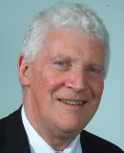
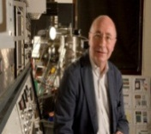
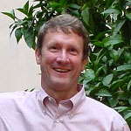
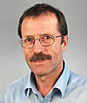
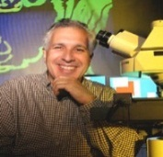


Plenary Speakers
Professor Peter Dobson – UK
Professor Christian Colliex – France
Dr Scott Fraser – USA
Professor Andreas Engel – Switzerland
Professor Jeff Lichtman – USA
Professor Tony Wilson - UK
Professor Daniel Schechtman- Israel

Slide 9
Agenda
Welcome and Event Overview - Professor Tony Wilson, RMS President
Scientific Programme - Dr Debbie Stokes, emc2012 Chair
Exhibition and other Events in the Hall – Ms Allison Winton, RMS Event Director
Event Promotion – Mr Rod Shipley, RMS CAB Chair
Delegate Social Programme – Ms Allison Winton
Logistics – Ms Allison Winton
Meet the Team
Venue Tour
Lunch
Notes:
9

Slide 10
Scientific Programme:
Physical Sciences - Applications
Symposium Chair: Professor Mark Rainforth
Session | Invited Speakers
Functional Materials | Susanne Stemmer – California, USA, Joachim Loos – Glasgow, UK Axel Lubk- Dresden, Germany, Amanda Petford-Long – USA
Thin Films, Coatings and Interfaces | Beata Dubiel – Poland Stuart Turner – Antwerp, The Netherlands
Art, Heritage and Forensics | Florian Meirer – Italy, Peter Northover - Oxford, UK
Advanced Materials | Dorte Juul Jensen – Denmark, Mark Aindow - Connecticut, USA Erdmann Spiecker – Erlangen, Germany, Velimir Radmilovic – Belgrade, Serbia
Healthcare I (multidisciplinary) | Bill Jones – Cambridge, UK, Alexandra Porter – London, UK Clive Roberts – Nottingham, UK, Marco Cantoni, France
Healthcare II (multidisciplinary) | Jonathan Powell – Cambridge, UK Nico Sommerdijk – Eindhoven, The Netherlands Jean Michel – Reims, France
Nanomechanics | Paul Zaxlansky, Germany
Towards Sustainable Energy and Environmental Protection | Prathiba Gai – York, UK, Stig Helveg – Denmark Ying Shirley Meng - USA
Earth and Planetary Materials | Penelope Wozniakiewicz – USA Patrick Orr – Dublin, Ireland
Low Dimensional Materials | Jamie Warner – Oxford, UK, Valeria Nicolosi – Dublin, Ireland Reine Wallenberg – Sweden, Quentin Ramasse - USA

Slide 11
Scientific Programme: Physical Sciences – Tools & Techniques
Symposium Chair: Dr John Hutchison
Session | Invited Speakers
Advances in Scanning Probe Microscopy: applications at the Nanoscale | Sebastian Loth - Germany, Jascha Repp - Germany Mervyn Miles- Bristol, UK, Bruno Samori – Bologna, Italy Olaf Magnussen – Kiel, Germany, Simon Scheuring, France
Advances in SEM Sponsored by Hitachi High Technologies | Ludek Frank – Czech Republic, Stefan Zaefferer – Germany John Mansfield – Michigan, USA, Mitsugo Sato - Japan
In Situ and Environmental EM | Peter Crozier – Arizona, USA, Henny Zandbergen – Delft, The Netherlands, Blythe G Clarke – Sandia, USA Stephan Hofmann – Cambridge, UK
3D/4D Imaging | Nestor Zaluzec – Argonne, USA, Simo Huotari – Grenoble, France Sara Bals – Antwerp, Belgium, Frank Muecklich – Saarland, Germany
Advances in EM Instrumentation & Methods (Professor David Cockayne Memorial Symposium) Sponsored by EMAG, IoP | Joachim Zach – Germany, Ondrej Krivanek – USA Sandra Van Aert – Antwerp, Belgium, Fabrizio Carbone – Lausanne, Switzerland, Ute Kaiser – Ulm, Germany, Peng Wang – Oxford, UK
Electron Diffraction and crystallography | Jim Zuo – Illinois, USA, Joke Hademann – Antwerp, Belgium
Advances in Spectroscopy in STEM and CTEM | Mathieu Kociak – Paris, France, Les Allen – Melbourne, Australia Jo Verbeeck – Antwerp, Belgium, Gianluigi Botton - Canada
Advances in Ion Microscopy | Diederik Maas – Delft, The Netherlands Daniel Pickard – Singapore, Ivo Utke – Switzerland Bruno Humbel – Lausanne, Switzerland
Emerging and Late Breaking Topics in Physical Science | TBD

Slide 12
Scientific Programme:
Life Sciences - Applications
Symposium Chair: Dr Peter O'Toole
Session | Invited Speakers
Organelle Dynamics | Gillian Griffiths – Cambridge, UK, Gero Steinberg – Exeter, UK Viki Allan – Manchester, UK Anna Akhmanova – Utrecht, The Netherlands
Biology of the Cell Nucleus | Christina Flors – Madrid, Spain, Paul Fransz – The Netherlands David Stanek – The Czech Republic
Cytoskeleton and signalling Sponsored by German Society of Cell Biology | Klemens Rottner – Bonn, Germany, Julie Plastino – France Justin Molloy – London, UK, Robert Goldman - USA
Applied Imaging brain structure and function across different spatial and temporal scales | Zoltan Nusser – Hungary, Valentin Nagerl – France Jason Rothman – UK, Axel T Brunger – USA, Stephen Smith – USA, David DiGregorio – France, Thomas Nevian – Switzerland, Judit Makara – Hungary, Nathalie Rochefort – Germany, Troy Margrie – UK, Angus Silver - UK
Uninvited Guests: visualising host-pathogen interactions Sponsored by SGM | Abraham Minsky – Israel, Nolwenn Jouvenet – France Michael Way – UK, Winfried Weissenhorn - France Kay Grunewald – Oxford, UK Friedrich Frischknecht – Heidelberg, Germany
Imaging and flow cytometry in cancer biology (Session in conjunction with 'Applications and Advances in High Content Imaging') | Paul Smith – Cardiff, UK, Margaret Harnett – Glasgow, UK Daniel J Ehrlich – Boston, USA Chris Bakal - UK
in vivo imaging of multicellular dynamics and complexity (session also appears under Tools & Techniques) Sponsored by Caliper | Benjamin Podbilewicz – Israel, James Brewer – Glasgow, UK Abigail Woodfin – London, UK

Slide 13
Scientific Programme: Life Sciences – Tools & Techniques
Symposium Chair: Professor Tony Wilson
Session | Invited Speakers
Super Resolution fluorescence microscopy for life sciences Sponsored by Hamamatsu | Mark Cannell – Bristol, UK, Andreas Schoenle - Germany, Melike Lakadamyali – Spain, Mark Bates - Germany
Applications and advances in High Content Imaging (session in conjunction with 'Imaging and flow cytometry in cancer biology') | Christian Conrad – Germany, Robin Ketteler - London
Probes for light and electron microscopy Sponsored by FEI | Andreas Hoenger – Colorado, USA Mark Ellisman - USA
Image Processing (3D microscopy, 3D image analysis and developmental imaging) | Marin van Heel – London, UK, Rainer Heintzmann – London, UK Alberto Diaspro - Italy
3D electron microscopy of structure-function relationships | Benoit Zuber – Berne, Switzerland Thomas Muller-Reicher TU Dresden, Germany
Techniques for imaging brain structure and function across different spatial and temporal scales (session also appears under Applications) | Judit Makara – Hungary, Nathalie Rochefort – Germany Troy Margrie – UK, Angus Silver - UK
in vivo imaging of multicellular dynamics and complexity (session also appears under Applications) | Michal Neeman – Israel Mark Coles – York, UK Jim Haseloff - UK
Emerging and Late Breaking Topics in Life Science | TBD

Slide 14
Pre Congress Workshops
A Practical Course on how to set up your light microscope
Euro BioImaging meeting
Aberration Corrected TEM and Exit Wave Reconstruction
Applications of FIB in Specimen Preparation and Nanostructuring
SuperSTEM workshop (to be held at Manchester University)
Precession diffraction (to be held at Manchester University)

Slide 15
Bursaries
Three different forms of Bursaries available to students who have submitted a paper for presentation.
RMS Bursaries – successful applicants will receive complimentary full meeting registration, an invitation to the opening reception and a contribution to travel expenses of up to €250 (depending on distance travelled). There will be up to 90 of these bursaries available, and the total of each bursary offered will have a value of up to €445
RMS/IFSM Bursaries – IFSM have committed to contribute $10,000, which the RMS will match, to award bursaries giving special consideration to would-be delegates from developing economic regions. This bursary therefore is intended to cover the full cost of travel, accommodation, registration fee and other associated costs of attending the congress. 10 of these bursaries will be available, with a value of $2,000 each.
RMS/EMAG Bursaries – EMAG have sponsored the session on Advances in EM Instrumentation and Methods, by committing to support students with special consideration being given to those from Eastern Europe. 2 bursaries will be available, with a value of up to €300 each. The bursary is intended to offer travel support but will not cover conference registration fees.

Slide 16
Micrograph Competition
The Royal Microscopical Society’s biennial International Micrograph Competition has been launched. This highly respected event will culminate with the winners being announced at emc2012.
The winning images will appear in high-circulation publications, providing great exposure for the successful entrants.
The competition has four categories; Electron Microscopy - Physical Science, Electron Microscopy - Life Science, Light Microscopy - Physical Science, and Light Microscopy - Life Science.
The following prizes have been offered so far:
Cash
iPod Nano
iPad
Compact Digital Camera with Carl Zeiss lens
Portable Hard Drive
Notes:
16

Slide 17
Agenda
Welcome and Event Overview - Professor Tony Wilson, RMS President
Scientific Programme - Dr Debbie Stokes, emc2012 Chair
Exhibition and other Events in the Hall – Ms Allison Winton, RMS Event Director
Event Promotion – Mr Rod Shipley, RMS CAB Chair
Delegate Social Programme – Ms Allison Winton
Logistics – Ms Allison Winton
Meet the Team
Venue Tour
Lunch
Notes:
17

Slide 18
Exhibition
Monday 17th (09.30) – Friday 21st (14.00) September 2012
95 confirmed stand bookings since exhibition space went on sale December 2010
Well over three-quarters of stand space sold
Excellent opportunities for exhibitors and delegates
Four workshop theatres
Poster village (space for 400 posters)
Floor plan and exhibitor listing on next slides
Notes:
OR
Outline the format of the exhibition – proposed opening and closing times – address any differences with the format of a conventional MICROSCIENCE, particularly duration – outline pricing, particularly incentives for previous exhibitors or RMS and/or EMS corporate members – highlight any EMS requirements for exhibitors (ECMA) – membership of CAC and stress flexibility of venue - what will exhibitors get for their money (shell, carpet etc.) – the support they will get (dedicated team of full-time experienced staff) - keen to make it the best exhibitor experience – there is enthusiasm for the event, and we want to harness it and for you to be an integral part –thank you
18

Slide 19
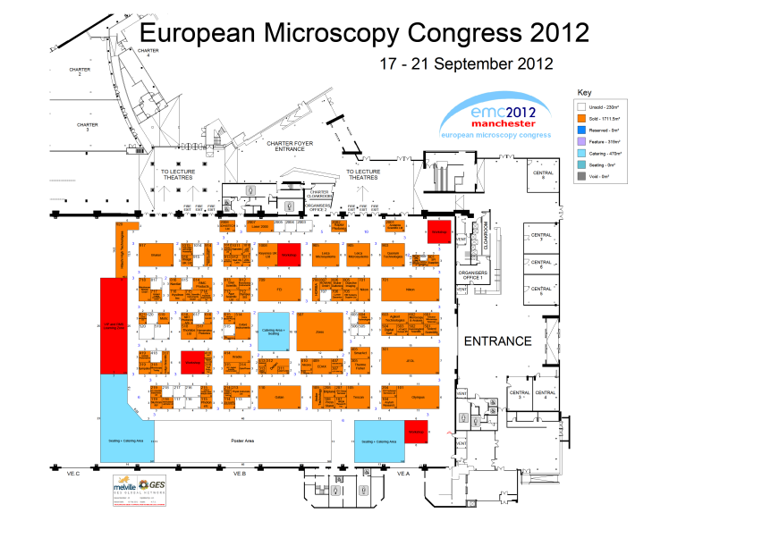

Slide 20
Exhibitor Listing
3DHISTECH Ltd
Acutance Scientific Ltd
(Cameca and Klocke Nanotechnik)
Agar Scientific Limited
Agilent Technologies
Alicona
Andor Technology
ASI / Applied Scientific Instrumentation
Asylum Research
Aurion Immuno Gold
Reagents & Acc
Bitplane
Bruker Datonics
Bruker Nano GmbH
Carl Zeiss
CN Technical Services Ltd
CoolLED
Deben UK Ltd
dEYEmond Scimed GmbH
Diatome Limited
Digital Surf
e2v Scientific Instruments
E A Fischione Instruments
EDAX
Electron Microscopy Sciences
Elliot Scientific Ltd
E M Systems Support
FEI Company
Gatan
Hamamatsu Photonics UK Ltd
Hitachi High Technologies Europe GmbH
HORIBA Scientific
HREM Research Inc
Hummingbird Scientific
HWL Scientific Instruments GmbH
Hysitron Inc
Imaging & Microscopy (GIT)
Imina Technologies
Indigo Scientific

Slide 21
Exhibitor Listing
Linkam Scientific Instruments
LOT Oriel Ltd
Lumen Dynamics
Mad City Labs Inc.
Märzhäuser Wetzlar GmbH &Co. KG
Microscopy & Analysis
Microscopy Today
Motic Spain S.L.U
Nanofactory Instruments
Nanotec
Navitar, Inc
Newport Spectra Physics Ltd
Intelligent Imaging Innovations GmbH
International Labmate
ISS Group Services Ltd
Jackson ImmunoResearch
Europe Ltd
JEOL UK
Keyence UK Ltd
Kleindiek Nanotechnik
Lambda Photometrics
Laser 2000
Laser Lines Ltd
Leica Microsystems (UK) Limited
Nikon UK
NKT Photonics A/S
NT-MDT
Objective Imaging Ltd
Olympus
Olympus Soft Imaging Solutions GmbH
OPTOPHASE
Oxford Instruments
Oxford University Press
Park Scientific
Pfeiffer Vacuum Ltd
Photometrics/Qimaging/Media Cybernetics

Slide 22
Exhibitor Listing continued
Photon etc.
Photonic Geräte GmbH & CoKG
Physik Instrumente Ltd (PI)
Prior Scientific Instruments Ltd
Quekett Microscopical Club
Quorum Technologies
Raptor Photonics Ltd
RMC Products
ROWIAK GmbH
SelectScience
SkyScan NV
SmarAct GmbH
Solent Scientific
SPECS Surface Nano Analysis GmbH
SPI Supplies
Surface Measurement Systems
Ted Pella Inc
Tescan
Thermo Scientific
Thorlabs Ltd
Tietz Video and Image Processing Systems GmbH
Tousimis
VSG-Visualizations Sciences Group
Xradia

Slide 23
Sponsorship
The following sponsorship opportunities have been reserved:
Opening Reception
Poster Reception-Wednesday
Branded Conference Bags
Exhibition Tote Bags
Branded Lanyards
Conference Programme
Printed ½ Page Advert in Conference Programme
Printed Full Page Advert
Inserts in the Conference Bags
Branded Water Coolers
‘You are here’ boards
Plasma Screen Adverts
Sponsorship of the emc2012 Exhibition page
Sponsorship of the emc2012 Registration page

Slide 24
Sponsorship Opportunities
The following sponsorship opportunities are still available;
Wine at Congress Dinner - Old Trafford
Old Trafford Museum Tour and Drinks Reception
Old Trafford Football Pitch Photo Opportunity
Poster Receptions - Monday, Tuesday and Thursday
Conference Proceedings on a Branded DVD Disc
Branded USB memory stick
Branded Pens in the conference bags
Branded Tea and Coffee
Wi-Fi in the Main Hall-sponsored landing page and Wi-Fi info cards
Display Banners Outside the Main Hall
Sponsorship of the emc2012 Conference website page
Sponsorship of the emc2012 SPM website page
Sponsorship of the emc2012 Workshops website page
Sponsorship of the emc2012 Social Programme website page
(reserved for Opening reception, Wine at dinner, Museum Tour, Photo Opportunity and Poster Reception sponsors)

Slide 25
Agenda
Welcome and Event Overview - Professor Tony Wilson, RMS President
Scientific Programme - Dr Debbie Stokes, emc2012 Chair
Exhibition and other Events in the Hall – Ms Allison Winton, RMS Event Director
Event Promotion – Mr Rod Shipley, RMS CAB Chair
Delegate Social Programme – Ms Allison Winton
Logistics – Ms Allison Winton
Meet the Team
Venue Tour
Lunch
Notes:
25

Slide 26
Event Promotion
Conference
Main promotion via emc2012 website (use of keywords, sponsored links on google)
EMS Mailings
Regular emc2012 email newsletters
Other Societies - SGM, EMAG, BSCB, SEB etc
Dedicated promotion for Neuroscience, and Life & Physical Sciences
Separate Emails for SPM (previous meeting registrations)
RMS website
MICROSCIENCE delegate lists
EMC 2008 Delegate lists
Regular updates in infocus magazine
Exhibitors to send out Call for papers pdfs, add link to website etc
Regular Articles in Imaging & Microscopy
Provide emc2012 advertising slides for session organisers to use at other events in run up to the event

Slide 27
Event Promotion
Exhibition (and general Conference)
Promotion nearer the time
Regular newsletters - Jan, End Feb, May, July, Early September
Press Releases
Contra deals and Advertising (Microscopy & Analysis, Imaging & Microscopy, International Labmate, Microscopy Today, Select Science, Materials Today, Materials World, Physics World, Quality Management Today, Lab Bulletin)
Local Organisations to Manchester (University & Industry), purchasing departments in hospitals
PR Company working on this – CooperRepco
Exhibitor publicity
Social Networking (facebook, twitter and LinkedIn)

Slide 28
Agenda
Welcome and Event Overview - Professor Tony Wilson, RMS President
Scientific Programme - Dr Debbie Stokes, emc2012 Chair
Exhibition and other Events in the Hall – Ms Allison Winton, RMS Event Director
Event Promotion – Mr Rod Shipley, RMS CAB Chair
Delegate Social Programme – Ms Allison Winton
Logistics – Ms Allison Winton
Meet the Team
Venue Tour
Lunch
Notes:
28

Slide 29
Learning Zone
The RMS Learning Zone will be a major feature in the Main Hall and will incorporate separate areas:
Scanning Electron Microscopy
Transmission Electron Microscopy
Light Microscopy
Digital Microscopy
Confocal Microscopy
Specimen Preparation
RMS Outreach Activities
RMS VIP Area
Companies will be contacted about loaning equipment next week.

Slide 30
Workshops
Workshop sessions will run between 11.00-16.15 Monday -Thursday and 11.00-13.15 on Friday
Each session will last 45 minutes
Workshop sessions will be assisted by RMS staff to monitor attendees
AV equipment, such as microphones and data projectors, will be provided in each workshop.
Workshop sessions are £100 +VAT per 45 minute session
The following companies have requested workshops so far;
Carl Zeiss
FEI Life Sciences and TILL Photonics
Lot Oriel Ltd
NT-MDT
Lumen Dynamics
Break out rooms are also available for hire during the Congress.

Slide 31
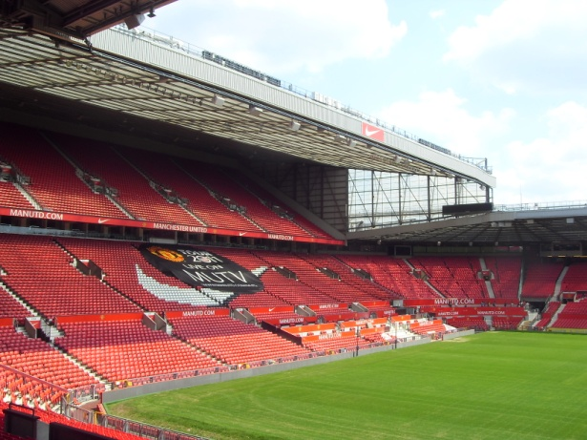
Social Events
Sunday 16th September – Welcome Reception at Manchester Central
Thursday 20th September – Congress Banquet at Old Trafford Football Club

Slide 32
Exhibitor Manual
The exhibitor manual is now available on the emc2012 website.
You can find links to ordering furniture, electrical installations, AV equipment, lunches on your stand and much more to help with the organisation of your exhibition stand.
Regular email newsletters are being sent to exhibitors, the next issue will be sent on 5th March 2012.

Slide 33
Contractors
The following contractors are here to help with enquiries:
Manchester Central – Venue
Melville – Shell, Carpet, Stand extras
Melville Logistics - Lifting and Storage
Bill Moule & Sons – Electrical Installations
Corporate Events – AV Equipment
Visit Manchester – Manchester Tourist Board

Slide 34
Venue and Catering
We will shortly be having a tour of the venue, to see:
Exhibition Hall
Access for setting up
Lecture Theatres
Break Out Rooms
On return there will be a buffet lunch

Slide 35
Meet the Team
As well as the various contractors, the following members of RMS staff are available during the tour and over lunch for questions:
Allison Winton Event Director
Karen Collins Administrator and Finance
Chloe Tarry emc2012 Exhibition Organiser
Jessica Stanley emc2012 Conference Manager
Victoria Masters Conference Manager
Sarah Bebb Conference Organiser
Melanie Reedman Outreach and Accounts
Thank you for coming to this Meeting, and we look forward to seeing you Manchester in September!

Slide 36
Agenda
Welcome and Event Overview - Professor Tony Wilson, RMS President
Scientific Programme - Dr Debbie Stokes, emc2012 Chair
Exhibition and other Events in the Hall – Ms Allison Winton, RMS Event Director
Event Promotion – Mr Rod Shipley, RMS CAB Chair
Delegate Social Programme – Ms Allison Winton
Logistics – Ms Allison Winton
Meet the Team
Venue Tour
Lunch
Notes:
36

